Slide 1



Data Analysis of UK Train Rides
PRESENTED BY :
Mirna Ayman Kamal
Heba Elsayed Khalil
Mohamed Ahmed Salem
Mariam Morris Fekry
-

Slide 2


introduction
This project involves analyzing railway network data using Power BI to understand operational performance, revenue, and customer behavior .
The report is based on data from journeys, stations, tickets, delays, and cancellations, and provides analytical dashboards to help make strategic decisions to improve service and increase revenue .

Slide 3


Problems encountered with the data:
1) Missing Values
2) Incorrect Data Formats
3) Excessive whitespace within text
4) Inconsistent Category Labels
5) Duplicate Records

Slide 4

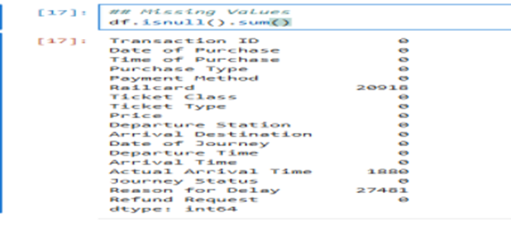
Python
1) Importing libraries
2) Reading the file
3) Data cleanliness

Slide 5
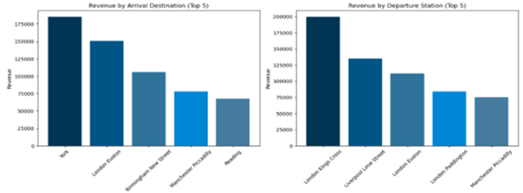
Visualization
1) Revenue By Arrival & Departure Station

Slide 6
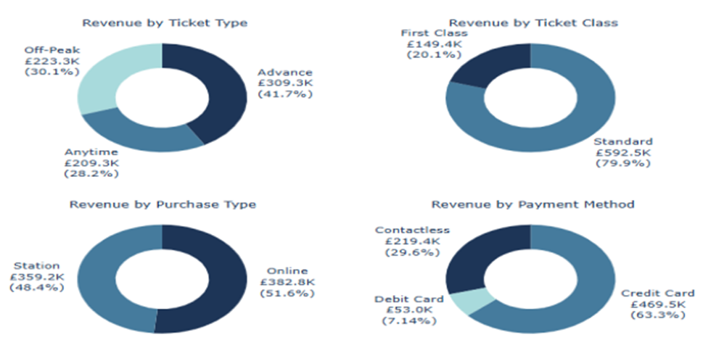
Visualization

Slide 7
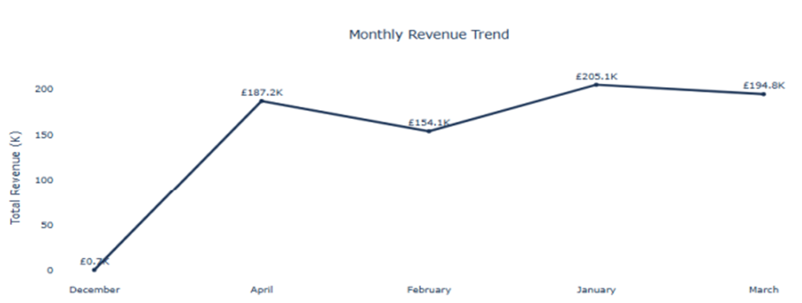
Visualization
2) Monthly Revenue Trend

Slide 8
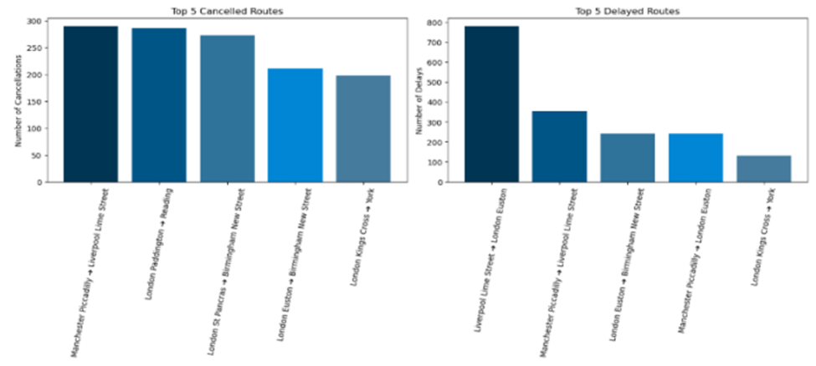
Visualization
3) Top 5 Cancelled & Delayed Routes

Slide 9
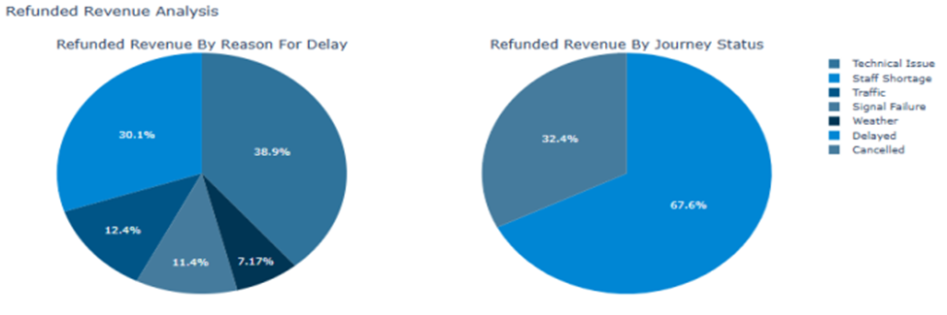
Visualization
4) Refunded Revenue by Reason for Delay & Journey Status

Slide 10

Power BI Dashboard
we created an interactive Power BI dashboard consisting of three pages to provide a comprehensive analysis of train journey data, covering performance, customer behavior, and revenue insights.

Slide 11
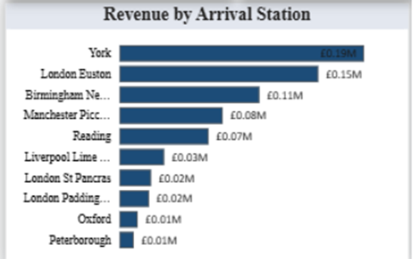
Revenue
Top revenue by arrival station:
•York is an important tourist and historical station → many trips from London.
• London Euston is the northern gateway and a major hub for fast trains.
• Birmingham and Manchester are business and daily travel cities.

Slide 12
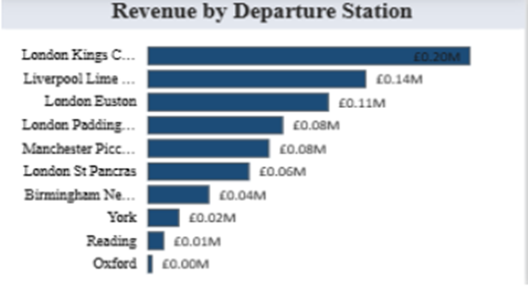
Revenue
Top revenue by departure station:
• London is a main travel hub between cities.
• Kings Cross specifically connects London to the North (Edinburgh, York).
• Liverpool and Manchester have significant business/university traffic.

Slide 13
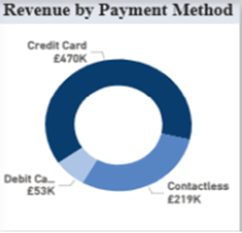
Revenue
Revenue by Payment Method
• British travelers mainly use credit cards for travel because they offer reward points.
• Contactless is very common within London stations and its use is growing.
• Debit cards are less used as they don’t provide benefits

Slide 14
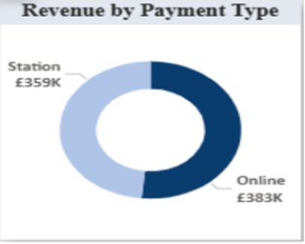
Revenue
Revenue by Payment Type (Station vs Online)
• Many rely on mobile or website ticket purchases.
• However, a significant portion still buys at stations due to:
o Last-minute trips
o Changing plans
o Lack of trust in apps

Slide 15
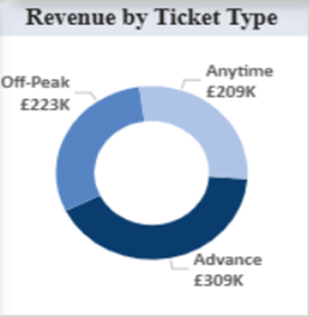
Revenue
Revenue by Ticket Type
• Advance is the highest because it’s cheaper, so many buy in advance.
• Off-Peak comes next as people avoid peak prices.
• Anytime is also high because it allows travel at any time, so the price is higher.

Slide 16
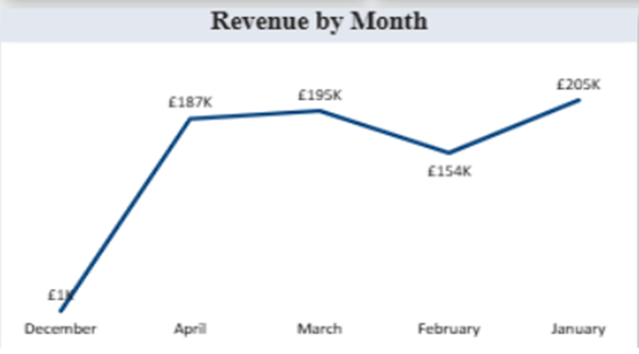
Revenue
Revenue by Month
• January usually sees high travel (return to school/work).
• March and April include Easter holidays → tourism travel increases.

Slide 17
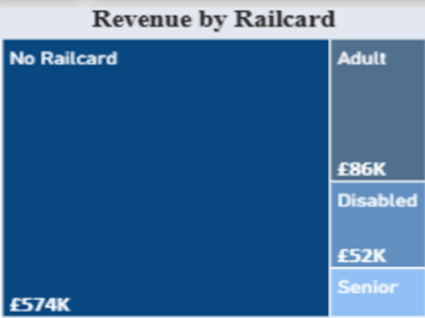
Revenue
Revenue by Railcard (Treemap)
• Most revenue comes from “No Railcard” because:
1. Their number is much larger.
2. They pay full price without discounts.
• Adult, Senior, and Disabled use discounts, so revenue from them is lower.

Slide 18
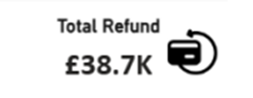
Delay & Refund
Total Refund: Total amount refunded to customers due to delays or cancellations.

Slide 19
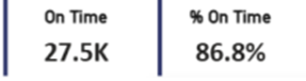
Delay & Refund
On Time: Number of journeys that arrived on time and their percentage of the total, indicating operational efficiency.

Slide 20
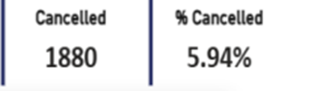
Delay & Refund
Cancelled: Number and percentage of cancelled journeys, reflecting service disruptions.

Slide 21
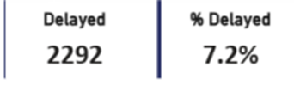
Delay & Refund
Delayed: Number and percentage of delayed journeys, showing punctuality performance.

Slide 22
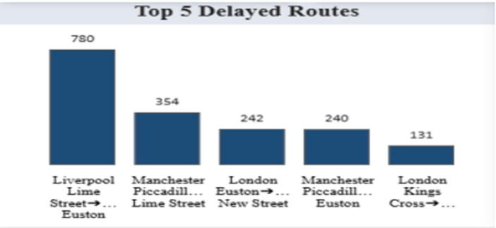
Delay & Refund
Top 5 Delayed Routes Bar chart showing the five routes with the highest delays:
• Liverpool Lime Street → Euston ranks first (780 delays).
• Followed by Manchester and London routes. Insight: These are high-traffic routes, which increases the likelihood of delays.

Slide 23
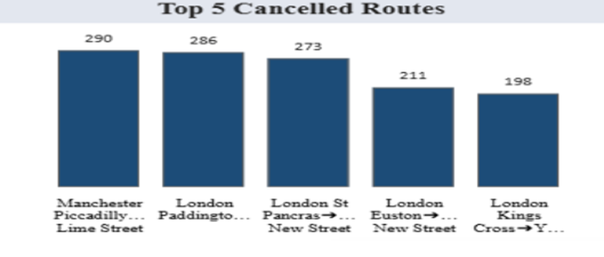
Delay & Refund
Top 5 Cancelled Routes Routes most affected by cancellations:
• Manchester Piccadilly → Lime Street leads the list.
• London Paddington → Reading also appears prominently.
Insight: Cancellations are concentrated on major routes, likely due to operational or capacity issues.

Slide 24
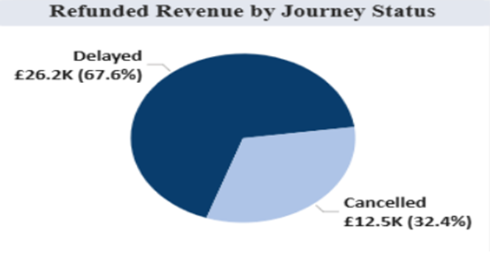
Delay & Refund
Refunded Revenue by Journey Status
Pie chart showing refund distribution by journey status:

Slide 25
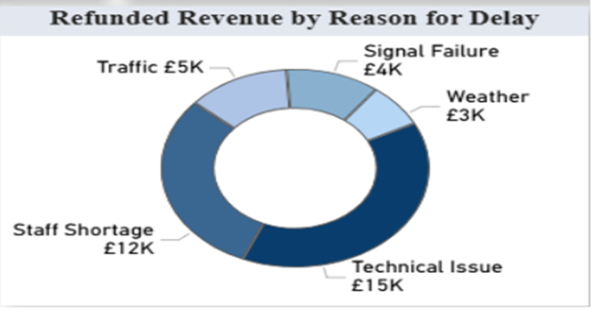
Delay & Refund
Refunded Revenue by Reason for Delay
Pie chart showing refund distribution by delay reason:
• Staff Shortage: £12K
• Signal Failure: £4K
• Weather: £3K Insight: Technical issues and staff shortages are the biggest contributors to revenue loss.

Slide 26
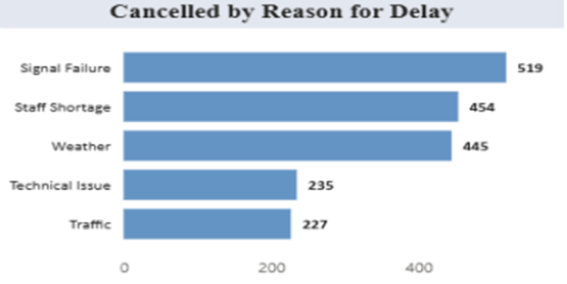
Delay & Refund
Cancelled by Reason for Delay
Horizontal bar chart showing reasons for cancellations:
• Signal Failure and Staff Shortage dominate. Insight: Infrastructure and workforce challenges are key drivers of cancellations.

Slide 27
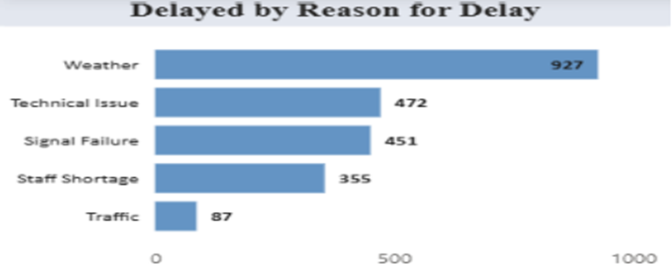
Delay & Refund
Delayed by Reason for Delay
Horizontal bar chart showing reasons for delays:
• Weather tops the list (927 cases).
• Followed by Technical Issues and Signal Failures. Insight: External factors like weather significantly affect punctuality.

Slide 28
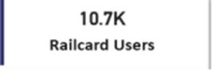
Customer & Purchase Behavior
1) Railcard Users
Shows the number of customers who used a Railcard during the period covered by the data.
• This means roughly one-third of users use a Railcard.
• This makes sense because Railcards offer a 33% discount on most train tickets, so many passengers prefer buying a Railcard to benefit from the discount.

Slide 29
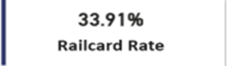
Customer & Purchase Behavior
2) Railcard Rate
Percentage of Railcard users out of all travelers.
• About one-third of passengers use Railcards, while the rest pay full price.
• This aligns with reality in the UK, where around 7 million people hold Railcards, but not all travelers are eligible (students, seniors, families).

Slide 30
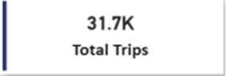
Customer & Purchase Behavior
3) Total Trips
Total number of trips made by users.
• Indicates high usage, suggesting the data represents a busy travel period such as work months or holiday seasons.

Slide 31
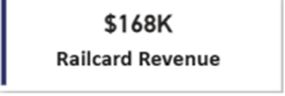
Customer & Purchase Behavior
4) Railcard Revenue
Total revenue from tickets purchased with Railcard discounts.
• Although Railcard holders get a discount, frequent travel results in high overall revenue.
• Railcard users often travel more than non-users because the cost is lower.

Slide 32
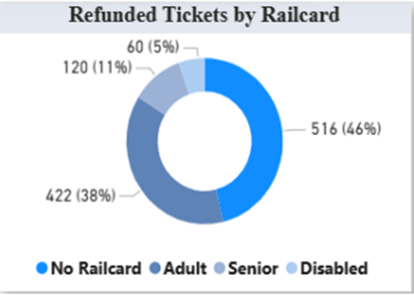
Customer & Purchase Behavior
5) Refunded Tickets by Railcard (Donut Chart)
Number of refunded tickets by Railcard type:
• “No Railcard” has the highest refund requests. Reasons:
1. This group is the largest overall, so naturally, refunds are higher.
2. Railcard users usually buy cheaper tickets → lower financial loss → fewer refund requests.
3. Some Railcard ticket types are linked to “non-refundable” fares.

Slide 33
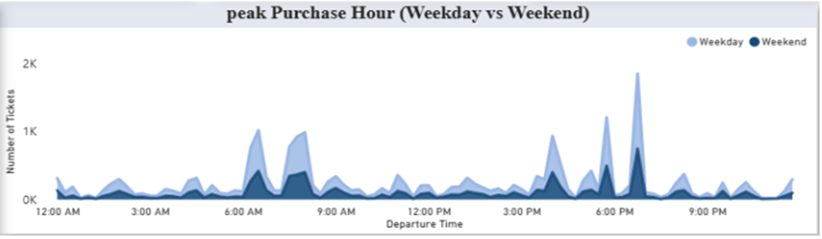
Customer & Purchase Behavior
6) Peak Purchase Hour (Weekday vs Weekend)
Ticket purchase timing during the day, comparing weekdays and weekends:
• Weekdays:
o Peak between 6–9 AM → commuters (employees/students)
• Weekends:
o Purchases spread more evenly throughout the day, as people travel for leisure rather than work.

Slide 34
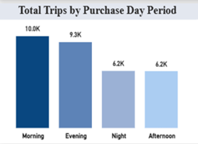
Delay & Refund
7) Total Trips by Purchase Day Period
• Highest number of trips purchased in: 1. Morning
2. Evening
• Lowest in Night
• Morning and evening represent train rush hours.
• Night is lower because trains reduce after 10 PM.
• Afternoon is moderate due to leisure travel.

Slide 35
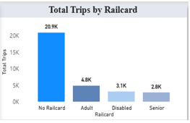
Delay & Refund
8) Total Trips by Railcard
1. Many passengers are employees with monthly or annual subscriptions that don’t require Railcards.
2. Railcards have age and eligibility conditions — not available to everyone.
3. Some travelers don’t travel frequently enough to justify buying a Railcard.

Slide 36
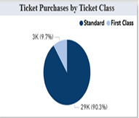
Delay & Refund
9) Ticket Purchases by Ticket Class
Insights:
• In the UK, most journeys are in Standard class because:
o Cheaper
o More seats available
o First Class is usually for long-distance or business travel
• A 10% share for First Class is very realistic for UK train data.

Slide 37


THANK YOU

